Slide 1
Teaching Writing Skills

Slide 2
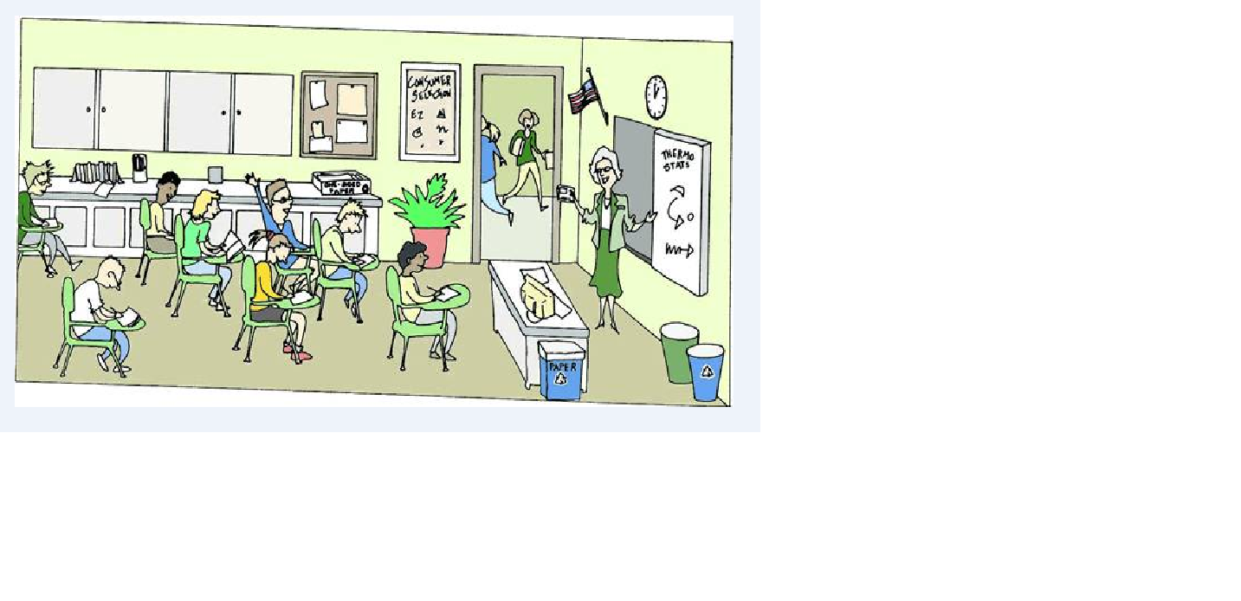

Slide 3
Write a sentence describing the picture…

Slide 6
Introduction : ( Internet sites)
The writing process- general explanation
http://www.youtube.com/watch?v=mY4O-
8IKxqc
Sentence structure:
http://www.youtube.com/watch?v=hsq2n4VOdzI

Slide 7
There is a birds

Slide 8
There Is an happy girl

Slide 9
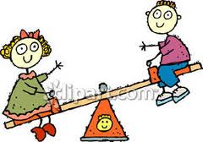
There is a Two boys

Slide 10
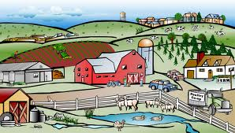
There Are an farms

Slide 11
There is 4 lions

Slide 12
Phase 1:
Each group focus on a certain topic.
Group A: there is / there are.
Group B: a / an.
Group C: dealing with the final product of each group.

Slide 13
Phase 2:
Students work in the school site.
They have to :
1. Come up with the rules for writing correct sentences.
2. Discuss different topics , sharing ideas.
(Lesson 2)

Slide 14
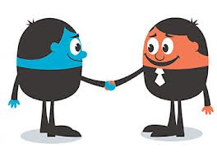
Phase 3
Students present their work.
1.They have to come up with the rules of the correct writing.
2. They have to present the solutions for the wrong sentences .
3. They have to describe pictures, by writing a simple sentence about each one .

Slide 15
Final Task :
Write 6 sentences about the picture

Slide 16
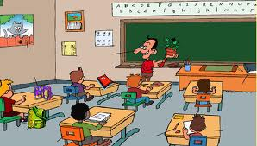

Slide 17
1._____________________________________
2._____________________________________
3._____________________________________
4._____________________________________
5._____________________________________
6.______________________________________

