Slide 1
Tasks:
To study the history of the Tower of London
To find out what ceremonies and traditions are connected with the Tower of London
To know what was the Tower of London in the past and what is the Tower of London today

Slide 2
Aim:
To find out interesting information about the Tower of London

Slide 3
The Tower of London
Why is the Tower of London one of the most visited spots in Britain?

Slide 4
Why are the ravens so important?

Slide 5
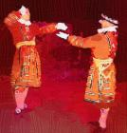
Special ceremonies

