Slide 1
Warm Up Activity
If you water the grass
if you leave now,
If I have time,
If you give me chocolate,
If it rains,
I will eat it.
.I’ll phone you later
I’ll stay at home.
It will grow up.
You won’t be late.

Slide 2
Warm up process
http://www.youtube.com/watch?v=fSDxMaC0QYc

Slide 3
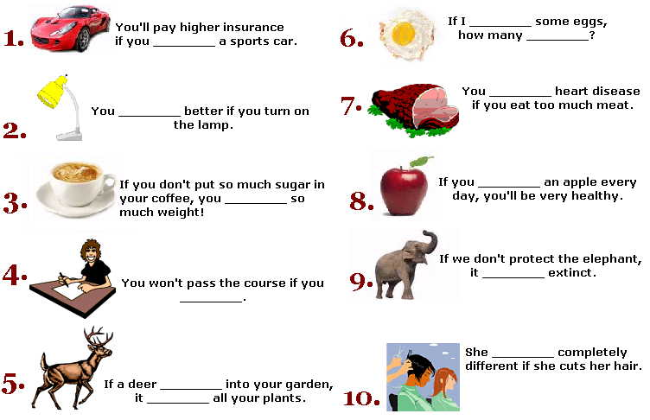
Process:

Slide 4
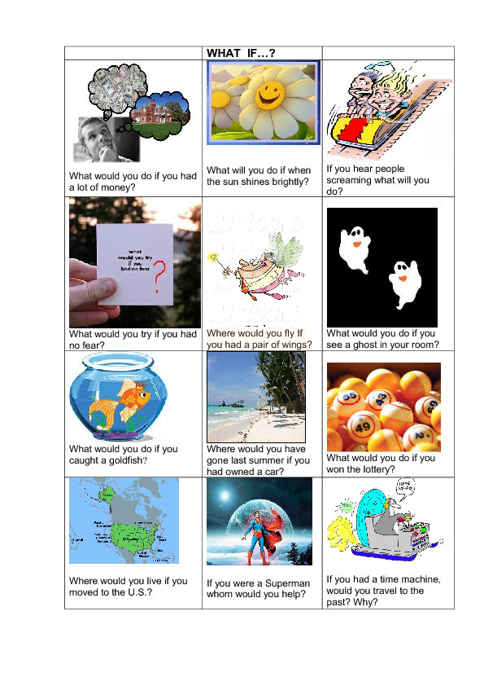
Closure

Slide 5
Evaluation tools:
exercise 1
exercise 2
exercise 3
exercise 4
Quiz 1
Quiz 2
Quiz 3

Slide 6
Homework
http://ies1libertas.edu.gva.es/departamentos/ingles/PDFs/tercero/efirstc3e1.pdf

