Slide 1
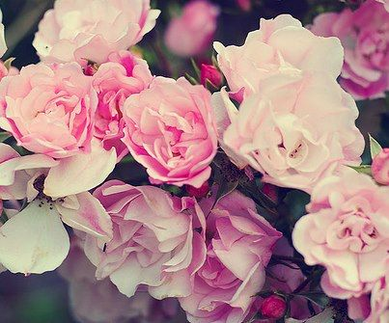
Regular and irregular plural nouns
Rajaa Egbaria
204471767

Slide 2
Lesson plan
Text Book:
Grammar book
Title of lesson:
Regular and irregular plural nouns
Content area:
Grammar
Teacher Name:
Rajaa Egbaria
Description of class:
Mixed ability class

Slide 3
General goals
students will able to :
1.Interact effectively in English.
2. Expose to new subject in grammar.

Slide 4
Specific Goals:
I want my students to be able to:
1.define the term singular number and plural number form of nouns .
2.know the rules of changing the number from singular noun to plural and vice versa.
3.solve the questions which they will taken.

Slide 5
Required materials:
Board : to write some definitions about topic and I will hang on it pictures .
Pictures
Paper : I will give each student a paper that contain the rules
The Grammar English book: - the school book which is related to the English subject, I will use it in order to teach through it.
Computer: - I will use it to show the students the video which related to the topic .
Worksheet : which contain exercises related to the topic.

Slide 6
Teaching Methodology/Techniques
*Opening/ Entry Behavior/ Warm up Activity:
Teacher greets the students ,ask them about their situations . he won’t tell the students about the topic of this lesson ,they have to figure out the topic through the lesson.
The teacher explain to students three stages of this lesson . First: they will see two pictures and answer orally the question about it , they have to figure out the topic of lesson.
Second :teacher will give them paper which written in it the rules.
Third : exercises and worksheets.

Slide 7
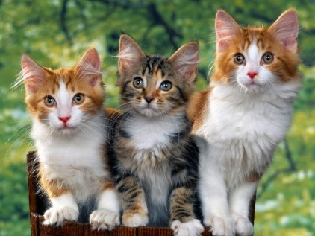
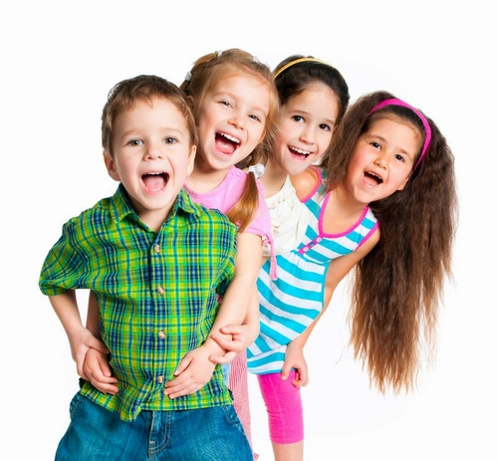
Step-by-step Procedures.
Teacher introduces the lesson by hanging pictures on the board .
1. What do you see in these pictures ?
2.what is the common property of these words?
I will listen to their answers

Slide 8
Brush your teeth.
Wipe the wishes.
Water the plants.
Mash the potatoes.
Put the toys on the shelves.
second , I will hang these sentences in the board :and ask students
Where are the Noun ?
Are they in plural or singular noun ?

Slide 9
while – stage : I will write in the board the definitions of Noun singular and plural nouns , and I will give examples for each one .
Like this :
Noun :
is a naming word used to name a person ,
place , animal or thing.

Slide 10
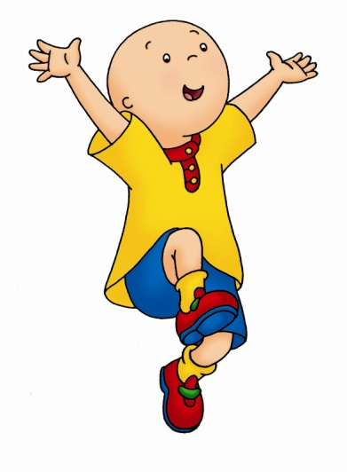
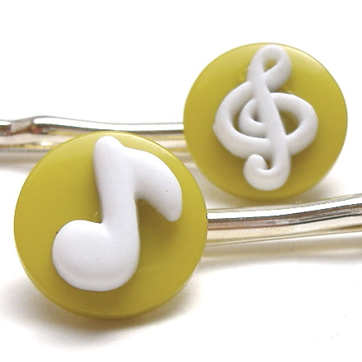
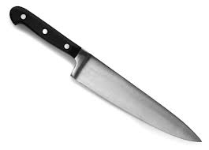
When a noun refers to only one thing or person , it is said to be singular in number .
A Child
A Man
A Knife
A Song

Slide 11
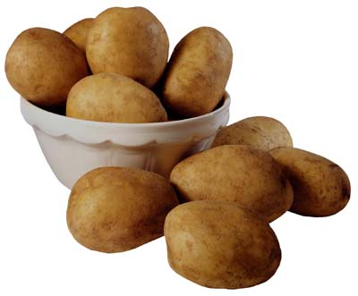
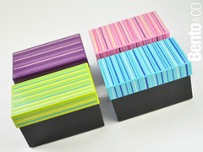
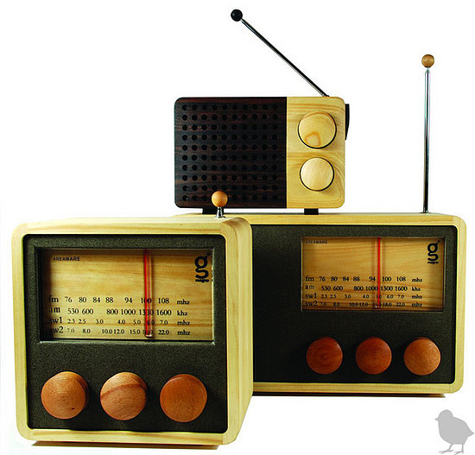
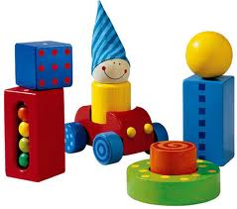
When a noun refers to more than one thing or person of the same kind , it is said to be plural in number .
Potatoes
Boxes
Radios
Toys

Slide 12
After that I will give them paper which written on it the rules .

Slide 13
Rules
Rule 1 : For Most nouns , just add –s.
Plural | Singular
Plants | Plant
Kites | Kite
Hats | Hat
Hands | Hand
Animals | Animal

Slide 14
Rules
Rule 2 :For nouns ending in -s,-x,-z,-ch,-sh add -es .
plural | singular
Boxes | Box
Branches | Branch
Dishes | Dish
Glasses | Glass
Buzzes | Buzz

Slide 15
Rules
Rule 3 : Final nouns ending in y and there is consonant before it , then the –y is removed and add-ies
Plural | Singular
Babies | Baby
Flies | Fly
Pennies | Penny
Sties | Sty
Spies | Spy

Slide 16
Rules
Rule 4 : Final nouns ending in y and there is vowel before it, then the –s is simply added.
Plural | Singular
Toys | Toy
Monkeys | Monkey
Trays | Tray

Slide 17
Rules
Rule 5 : For some words ending in -o , add - es
Plural | Singular
Potatoes | Potato
Tomatoes | Tomato
Heroes | Hero
Echoes | Echo

Slide 18
Rules
Rule 6 : For some nouns that end in -o add only –s to form the plural.
Plural | Singular
Autos | Auto
Kangaroos | Kangaroo
Photos | Photo
Pianos | Piano
Videos | Video
Solos | Solo

Slide 19
Rules
Rule 7 : Some nouns that end in –o add either –es or –s to form the plural .
Plural | Singular
Mementos / mementoes | Memento
Tornados / tornadoes | Tornado
Volcanos / volcanoes | Volcano

Slide 20
Rules
Rule 8 : For some nouns ending f , change the f to a v and add –es
Plural | Singular
Halves | Half
Wolves | Wolf
Elves | Elf
Lives | Life
Selves | Self

Slide 21
Rules
Rule 9 : For some nouns ending f , we add simply –s .
Plural | Singular
Beliefs | Belief
Chiefs | Chief
Cliffs | Cliff
Roofs | Roof
refs | Ref

Slide 22
Rules
Rule 10 : Some nouns have the same singular and plural form .
Plural | Singular
Fish | Fish
Deer | Deer
Sheep | Sheep
Means | Means
Species | Species
Series | Series
Shrimp | Shrimp
Salmon | Salmon

Slide 23
Rules
Rule 11:Some nouns that English has borrowed from other languages have foreign plurals .
Plural | Singular
Criteria | Criterion
Phenomena | phenomenon
Data | Datum
Media | medium
Bacteria | bacterium

Slide 24
Rules
Rule 11:Some nouns that English has borrowed from other languages have foreign plurals .
Plural | Singular
Bases | Basis
Crises | Crisis
Hypotheses | Hypothesis
Parentheses | Parenthesis
Theses | Thesis
Curricula | Curriculum

Slide 25
Rules
Rule 12 : For some nouns , changes other letters or just change the word completely .
Plural | Singular
People | Person
Children | Child
Feet | Foot
Oxen | ox
Men | Man
Mice | Mouse
Lice | Louse
Geese | Goose
Teeth | Tooth

Slide 26
*Post- stage:-
Teacher will give students various exercises about plural nouns , they will use the rules which are written on the board .
Evaluation strategies:
After they finish solving the questions , I will give students to write their answers on the board to make sure that they understood the lesson and they can solve the questions without difficulties .
*Closure:
I will thank the students for their participation.
*Homework:
I will give them homework from the grammar book about the plural nouns

Slide 27
Exercise 1 : read the passage and write if the noun singular or plural.
One day Nasreddin went to town to buy new clothes. First he tried on a pair of trousers. He didn't like the trousers, so he gave them back to the shopkeeper. Then he tried a robe which had the same price as the trousers. Nasreddin was pleased with the robe, and he left the shop. Before he climbed on his donkey to ride home, the shopkeeper and the shop-assistant ran out. "You didn't pay for the robe!" said the shopkeeper. "But I gave you the trousers in exchange for the robe, didn't I?" replied Nasreddin. "Yes, but you didn't pay for the trousers, either!" said the shopkeeper. "But I didn't buy the trousers," replied Nasreddin. "I am not so stupid as to pay for something which I never bought.

Slide 28
Exercise 2 : Match between the singular word and its plural.
Potato wives
Book ladies
Wife cars
Lady bikes
baby
potatoes
Watch dogs
Bike books
Dog watches
Car babies

Slide 29
Exercise 3: choose the correct form of plural
1. The ……………were singing outside our window.
1. Birdes
2. Birdies
3. Birds
4. Birdees
2. The …………… in my class twice the …………………..
1. Girls, boies
3. Girlies, boys
3. Girls, boyies
4. Girls, boys
3. There are many ……………………. In this town!
1. Houses
2. Housies
3. Houses
4. House

Slide 30
4. The two ………………… have a lot in common.
1. Country
2. Countries
3. Countrys
4. Countryies.
5. this country has five ………………………..
1. Librarys
2. Libraries
3. Libaryes
4. Library
6. I have three……………..and two ……………….
1. Uncles, aunties
2. Unclies, aunts
3. Uncles, aunts
4. Uncle, aunt

Slide 31
Exercise 4 : Write down the correct form of plural
City : ………………….
House :……………...
Boy :……………….
Family :………………..
Life :………………….
Photo:…………………
Phone :…………………
Sandwich :………………..
Nurse :…………………..
Elf: ………………..
Criterion :…………………
Toy :…………………
Village :………………
Phenomenon :…………………………..

Slide 32
Exercise 5 Complete the sentences . write the plural form of the correct word from the word pool in each blank space.
1.There are three ……………… and four …………………… in my art class
2.My neighbors next door have six ……………………………….
3.People have two arms , two hands , two legs and two ………………………………………….
4.Human have 32 ……………………….. in their …………………………... by the time they are adults
5.The ………………….. of year are spring , summer , winter , and autumn or fall.
6.The …………………… on the trees change color in autumn .
7.There are forks , …………………………. And spoons on the table .
8.There are trees , flowers , and …………………………. Outside around the house
9.Mumbai and Calcutta are two ………………………. In India .
10.M y family has several pets. We have a dog , two cats , and five ……………………………
Bush , child , city , fish , man , mouth ,season
Leaf , woman , tooth , knife , foot

Slide 33
Exercise 6 choose the correct answer .
1. How many person / people study English as a second language ?
2. Five woman / women opened a computer services company .
3. there is a cat / cats in the class
4. each child / children has to have a pencil.
5. I bought some tomato / tomatoes from the shop .
6.my tooth / teeth are sensitive to the cold.
7. my family consists of five member/ members .
8. I have two brother/brothers , and one sister / sisters .

Slide 34
Exercise 7 Correct the errors in the sentences , some sentences contain no errors.
1. Will you wash the breakfast dishs, please?.
2. Flies was buzzing around the picnic tablies.
3. Please put away your toys.
4. they were heroes for standing up to the government.
5. You aren't allowed to take photoes inside the theater.
6. She broke each cookie into halvies.
7. He gets angry if anyone challenges his religious beliefs.
8. Bacterium plural of bacteria .
9. We're having fishs for dinner.
10. The house was infested with mouses and ratis.

Slide 35
Who will win the million ?

Slide 36
Review
And
Enjoy

Slide 37
Thank you ☺

