Slide 1
Warm up activity
Read the following short story, and answer these questions:
- When does the story take place?
-What elements do the sentences in red have in common?

Slide 2
Good night Mr. Bill

Slide 3
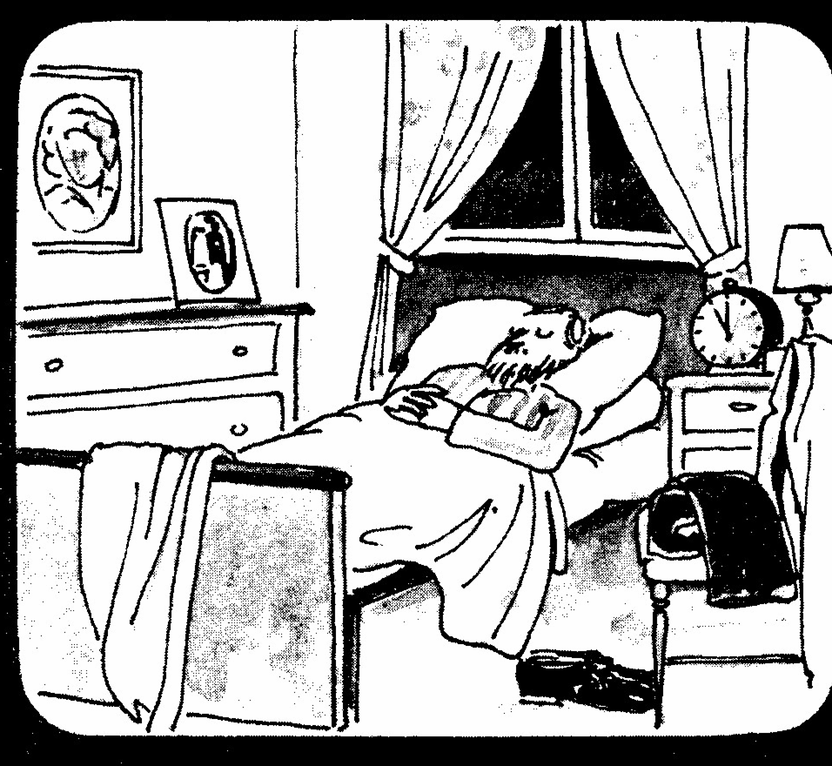
It is night. It’s eleven o’clock.
Mr. Bill is in bed. His eyes are closed.
He is sleeping.

Slide 4
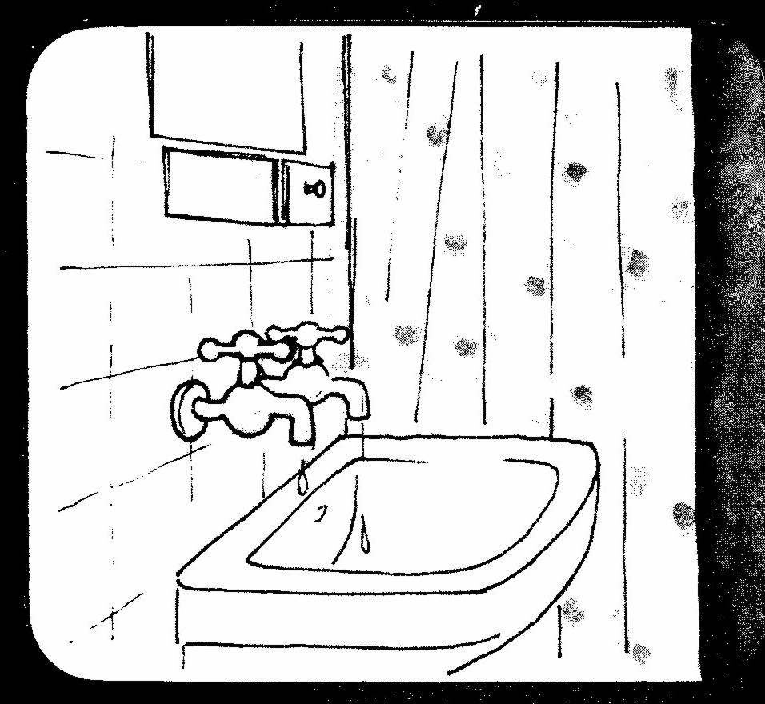
Listen! The taps are dripping

Slide 5
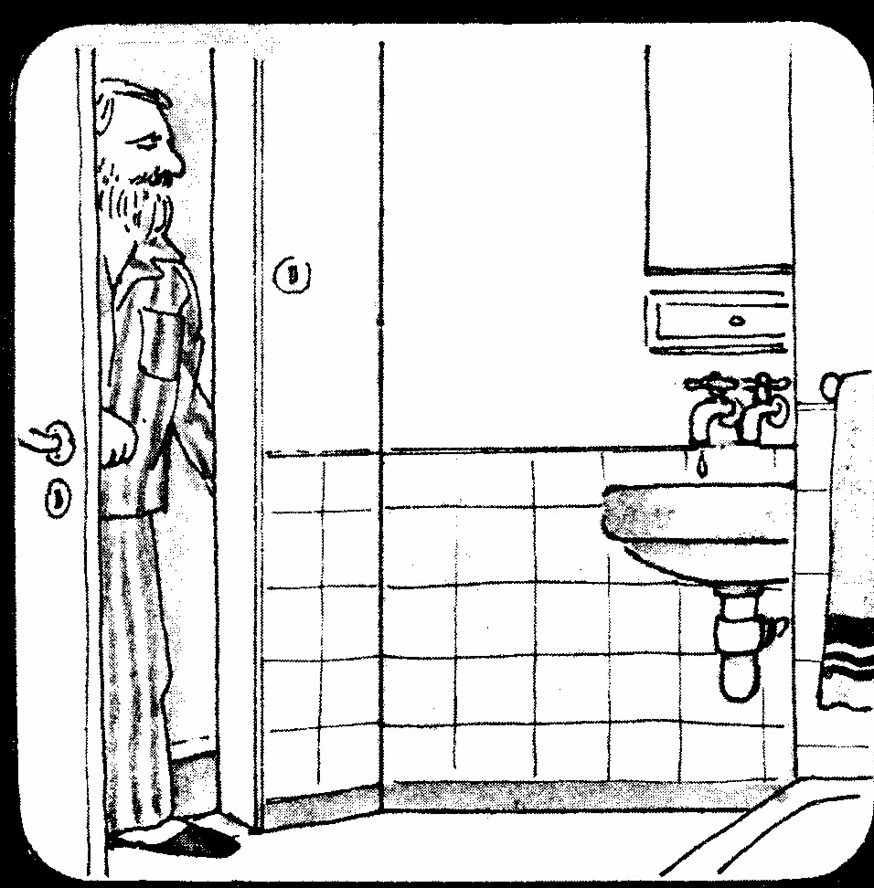
Mr. Bill is walking to the tap

Slide 6
He is standing near the taps. Listen It is quiet now

Slide 7
Mr. Bill is in bed again.
His head is on his pillow.
His eyes are closed.
Sh! Mr. Bill is sleeping.

