Slide 1

Angham wattad – Second Year Student
Comparison Degrees (Adjectives)

Slide 2
What do you see in this picture?

Slide 3
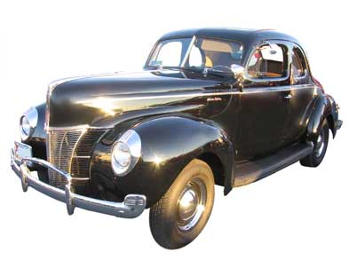
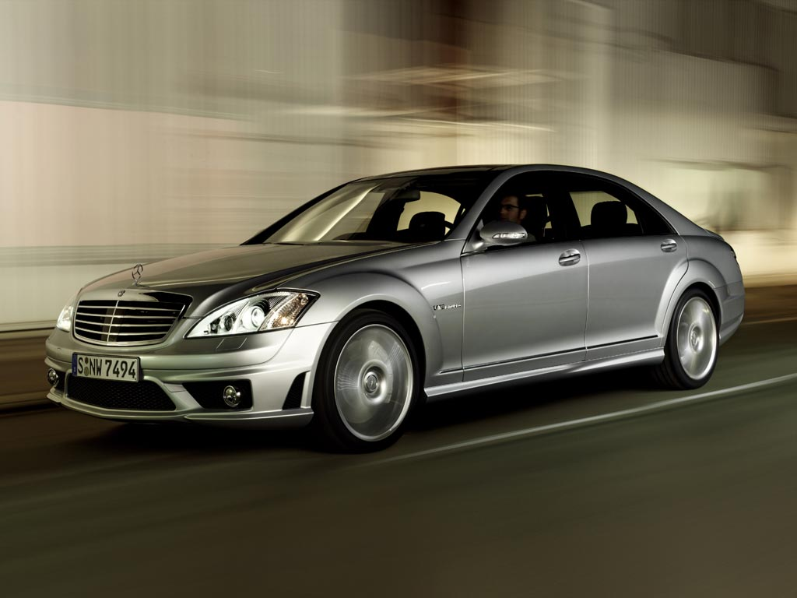
What do you see in these pictures?

Slide 4
Comparison Degrees (Adjectives)

Slide 5
We have three degrees of comparison:
Positive Degree
Comparative Degree
Superlative Degree

Slide 6
Positive Degree
Positive Degree
Degree of equality
Degree of inequality
The adjective is in positive form showing that two persons or things are the same – two nouns having the same quality.
The pattern is :
S + to be+ as + adj +as
The adjective is in positive form showing that two persons or things are not the same – two nouns that don't have the same quality.
The pattern is :
S + to be+not+ as + adj +as
My book is as interesting as yours
My book is not as interesting as yours

Slide 7
Practice !
as strong
John is ________ (strong )as James.
My brother is ___________ (hungry) as me.
Peter is ____________ (not fast )as Paul.
His car runs _________ (fast )as a race car.
Their house is_______ (big) as that one.
as hungry
not as fast
as fast
as big

Slide 8
Comparative Degree
We use it when we compare between two things or people.
Ex :
Ahmad’s house is bigger than Ali’s.
Ali’s house is smaller than Ahmad’s.
3. Ahmad’s house is more bountiful than Ali’s house.
Ahmad’s house
Ali’s house

Slide 9

The comparative forms from the previous example are:
-bigger than
-smaller than
-more beautiful than
So . . . When do we use “–er” and when do we use “more?”
Here are the rules

Slide 10

How many syllables are the adjectives : “big” and “small”?
Right one syllable
How many syllables is the adjective: Comfortable ?
Right 4 syllables
So what can we conclude ?

Slide 11
We can conclude that :
∞The Pattern for 1 syllable :
S + to be + adj + er + than
Example : Bill runs faster than Bob
∞The pattern for more than one syllable:
S + to be + more + adj + than
Example : Some people think that Spanish is more difficult than English.

Slide 12
You have to remember that there are some rules for adding –er:
1) If the one –syllable adjective ends with the letter “e,”
JUST add “r” to the end.
Examples: nice-nice wise-wiser
2) If the one-syllable adjective has a C-V-C pattern,
Double the consonant and add “er.” we don’t ever double the x,y,w
Example: Big – Bigger
3) For the two-syllables adjectives that ends with the letter “y,” DROP the “y” and add “ier.”
Example : Happy – Happier
4) Irregular comparatives:
Example : Good – better than Bad- worse than
So for the adjectives (Good, Bad) you cant add – er .

Slide 13
Example for the Irregular comparatives:
Sara’s grades are better than Michael’s.

Slide 14
Complete the chart with the comparative form of the adjectives
Adjective | Comparative form
Tall
Famous
Long | longer than
Comfortable
Good
bad | Worse than
amazing | more amazing than
Expensive
taller than
more famous than
more comfortable
better than
more expensive than

Slide 15
Practice !
1. I think Social Studies is _________________ (interesting) than Math.
2. San Diego is _____________ (beautiful) than L.A.
3. A dog is usually _______________ (friendly) than a cat.
4. It is _____________ (hot) today than it was yesterday.
more interesting
more beautiful
more friendly
hotter

Slide 16
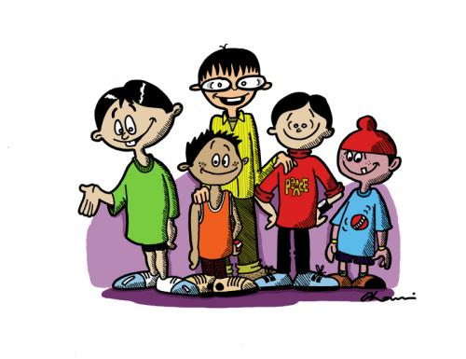
Superlative Degree
It is used to compare one thing with two or more other things.
EX:
John
John is the tallest boy in the team.
The queen of England is the richest woman in England.
Football is the most popular sport in Israel.

Slide 17
*the tallest
*the richest
*most popular
So . . . When do we use “–est” and when do we use “most?”

Slide 18
∞The pattern for 1 syllable :
S + to be + the + adj + est
Ex: Lake Baikal is the deepest lake in the world.
∞The pattern for more than two syllables:
S + to be + the most + adj
Ex :That was the most boring film I have ever seen

Slide 19
The rules for adding the –est , are the same as the rules for adding the –er.
But in the irregular forms of (good,bad), we have different words:
Good-The best
Bad- The worst
Irregular Superlative :

Slide 20
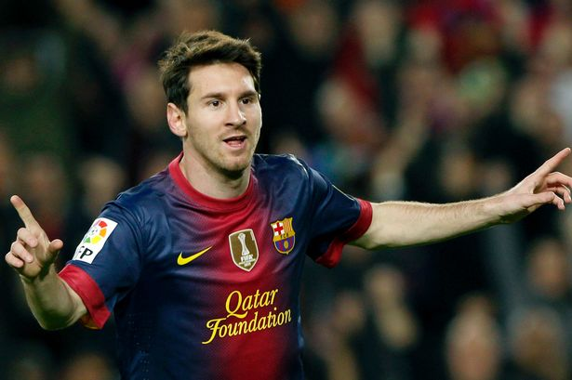
Example for the irregular Superlative
Messi is the best football player in the world.

Slide 21
Complete the chart with the comparative and superlative form of the adjectives
Adjective | Comparative form | Superlative form
Tall |  | the tallest
Famous
Long | longer than
Comfortable |  | the most comfortable
Good
Expensive
amazing | more amazing than
bad | Worse than
taller than
more famous than
the most famous
the longest
more comfortable
better than
the best
more expensive than
the most expensive
the most amazing
the worst

Slide 22
Practice !
the longest
1)The Amazon is ____________ (long) river in the world.
2) This bed is _____________________(comfortable) bed in the store.
3) Ahmad is __________ (good) player in his team.
4) Did you read Linda’s story? it is ________________ (beautiful) story I’ve ever read.
the most comfortable
the best
The most beautiful

Slide 23
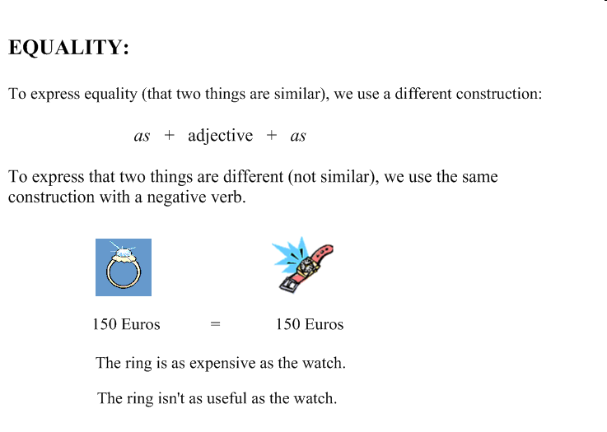
Review For Comparison Degrees

Slide 24





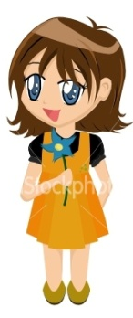
Jupiter is the largest planet of all.
Earth is larger than Mercury
Mercury is a large planet.
Sarah is the tallest girl in the class.
Mary is taller than Anna
Anna is shorter than Mary

Slide 25
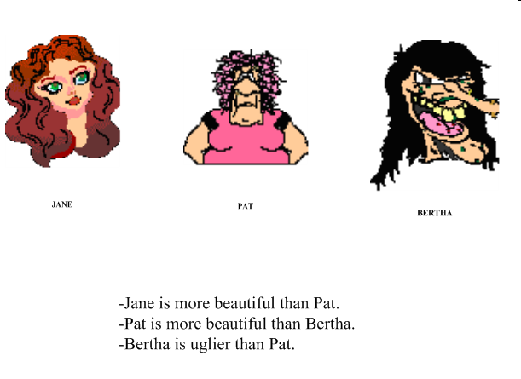
Lena
Meredith
Jena
Lena is more beautiful than Jena.
Jena is more beautiful than Meredith.
Meredith is uglier than Jena.

Slide 26
Competition
The class must be divided into two groups :
http://www.quia.com/cb/832199.html

Slide 27


Thanks for participating

