Slide 1
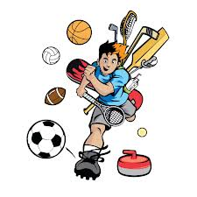
Sports

Slide 2
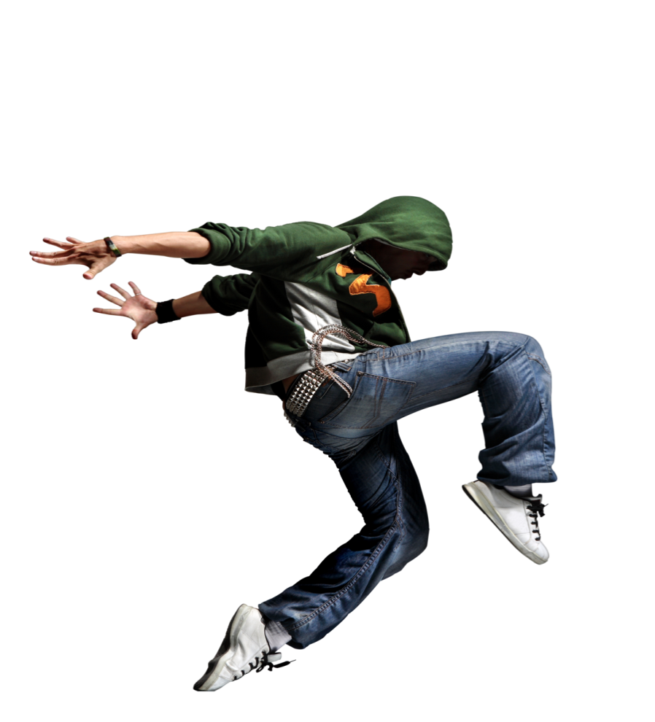
The world of breakin’

Slide 3
Breakdancing started in 1970s in the poor neighborhoods of the United States . There were usually no organized sports or activities after school , so the kids met in the streets .
There they learned the moves and dances and competed with each other .

Slide 4
organized
organized (adj) – منظم
Antonym – disordered \ messy – فوضوي

Slide 5
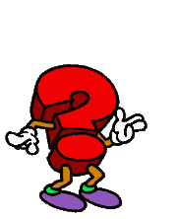
Why should people practice some sports ?

Slide 6
1. Playing sports is fun.
2. Physical activities are a good way to relieve stress and reduce depression.
3. Sports help develop teamwork and leadership skills.
4. Regular exercise increases quality of life.
5. Playing sports makes people less likely to be overweight.

Slide 7
competed
Can you describe the picture ?
Compete (v) – تنافس

Slide 8
Breakdancers move fast, with a lot of energy. Breakdance is often done to rap music. In rap, the singer doesn’t really sing. He talks in rhymes and invents as he goes a long. The same is true of breakdance. A good “b-boy” or “b-girl” (breakdancer boy or girl) can invent the moves while he or she is dancing. The same move can be done differently by different dancers. There is no one right way to break dance. What is important is having your own personal style.

Slide 9
Rap
A style of popular music believed to have its beginnings in African-American inner-city street culture.
Rap musicians generally perform in a vocal style in which the lyrics are spoken, rather than sung .
This type of music often deals with the hardships of inner-city life .

Slide 10
Rhymes
A rhyme is a repetition of similar sounds in two or more words, most often at the end of lines in poems and songs .
"Way up North, where there's ice and snow, there lived a penguin and his name was Joe."

Slide 11
But breakdance isn’t easy. The dancers have to work hard to do the moves well. There are no special costumes, but the dancers must dress comfortably. They wear big, loose clothes that let the move easily to the music. The results are truly amazing to see!

Slide 12
Special (adj) – مميز
Synonym – extraordinary
Antonym – normal \ ordinary

Slide 13
loose
loose (adj) - فضفاض

Slide 14
Time for questions !

Slide 15
1) breakdancing started in ?
2) the first breakdancers danced in ?
3) ……………….. Music is often used in breakdance.
4) In breakdance , it is important to do the moves …………….
5) Breakdancers wear …………….
6) what is rhymes ?
7) what is rap ?

Slide 16
Evaluation
Give yourself 10 points for each correct answer !
0-30 you have a lot to learn about the world of breakin’
40-50 you are interested in the world of breakin’ and pretty cool. Keep up the good work !
60-70 you are an expert on breakdance ! You must be a b-boy or b-girl yourself. Keep on breakin’

Slide 17
1) neighborhoods
2) organized
3) activities
4) each other
5) rap
6) done
7) loose
8) special

Slide 18
