Slide 1
Ballet

Slide 2
Questions
1) the first ballet school was in ……..
2) the first professional ballet dancers were ….
3) the first ballet dancers wore …….
4) in ballet there are …….
5) dancing on the tips of the toes is …….

Slide 3
When you watch a ballerina leaping gracefully across the stage, it seems so easy. What the audience does not see, however, is all the hard work that goes into it. Io order to dance really well, a ballet dancer must practice for hours and hours each day.

Slide 4
Leaping
Leap (v) – قفز
Synonym - jump

Slide 5
gracefully
gracefully - برشاقة

Slide 6
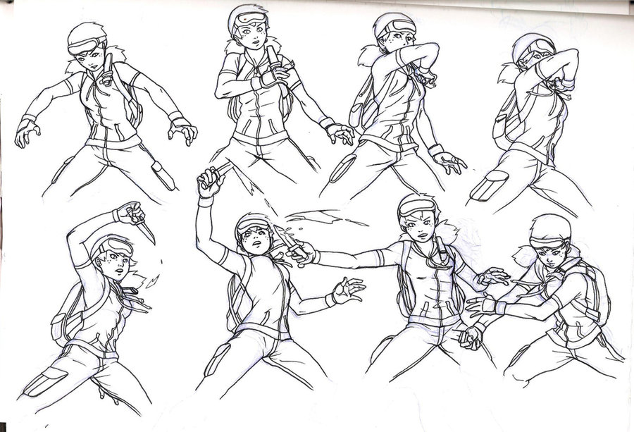
practice
Practice – يمارس
Synonym – exercise

Slide 7
That wasn’t always true. When ballet first begun, anyone could do it-including kings and queens. In fact, the first professional ballet school was started by King Louis XIV of France in 1672. The king, it is said, was quite a good dancer himself!
At first, only men danced professionally. They often wore big hats and wigs. When women were finally allowed to perform, they wore heavy skirts down to the floor. This made dancing very difficult !

Slide 8
محترف

Slide 9
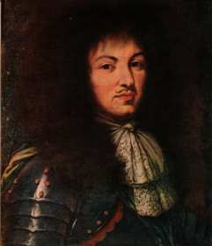
5 September 1638 – 1 September 1715
Known as Louis the Great .
Ruled as king of France .
His reign (حكم)of 72 years
and 110 days is one of the longest in French and European history .

Slide 10
الى حد بعيد
تماما

Slide 11
Wore (v3) – لبس
Wear (v)

Slide 12
wigs
Wigs – الشعر المستعار

Slide 13
skirt
Skirt – تنورة

Slide 14
There are five basic positions in ballet. These positions tell dancers exactly how to hold their arms and legs. Dancing gracefully on the tips of the toes is a special technique used only in ballet. In order to help them do this more easily, the dancers wear toe shoes-special shoes with hard toes.

Slide 15
technique – أسلوب
Synonym – style \ way

Slide 16
Some of the world’s most beautiful music was written for ballet. The music for three of the most famous ballet was written by Peter Illyich Tchaikovsky, a Russian composer. You may have heard of them: The Sleeping Beauty*, Swan Lake* and The Nutcracker*.

Slide 17
composer
Composer - ملحن

Slide 18
music
The Sleeping Beauty : http://www.youtube.com/watch?v=OxqyeoDSxTw
Swan Lake : http://www.youtube.com/watch?v=gP132E-xABg
The Nutcracker : http://www.youtube.com/watch?v=dK3-fNnsM3w

