Slide 1
UNIT 5: JUST READ IT!
Word puzzle.
Types of books.
Words with more than one meaning.
Superlative.
Vocabulary.
Idiom
Learn English with
Mahmood

Slide 2
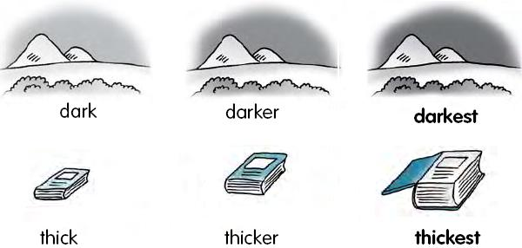
Superlative (exercise # 4, page: 91)
Why do we use a superlative adjective ?
We use a superlative adjective to describe one thing in a group of three or more things.

Slide 3
Practice, practice and practice again ;)

Slide 4
If you know it, you are AWESOME!
Exception The following adjectives have irregular forms:
 | Good
the worst | Bad
The least | Little
 | Many

Slide 5
One last questions before we move to the worksheet..
When do we not add “the” before the superlative adjective ?
When we compare one thing with itself, we do not use "the“.
For example:
Brazil is coldest in winter. (not the coldest)

Slide 6
Worksheet time !

Slide 7
Idioms
Idioms have meanings that can't be figured out by looking up the words in the dictionary. They have meanings that are understood by people who speak that language, but are very hard to understand for people who don't speak that language.
For example:
Spelling the word ❛flower❜ is ”a piece of cake”.
”a piece of cake”= very easy.

Slide 8
“Read between the lines” to try to understand what is meant by something that is not written explicitly or openly
Word puzzles (exercise # 5, page: 91)

Slide 9
“Face to face”, if two people meet or talk face to face, they meet or talk when they are both together in the same place.

Slide 10
“Time after time”= over and over (again).

Slide 11
“”See eye to eye” to agree about someone or something with someone else.

Slide 12
A “heart-to-heart” is a honest conversation with someone, where you talk honestly about issues, no matter how painful.

Slide 13
Words with more than ONE meaning (exercise # 7, page: 91)
date date.
left left.
may may.
run run.
close close.
fly fly.
Now is your turn! ☺
Please give me one more word with TWO meaning.

Slide 14
TYPES OF BOOKS

Slide 15
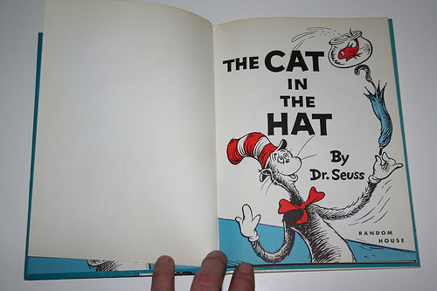
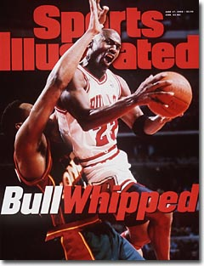
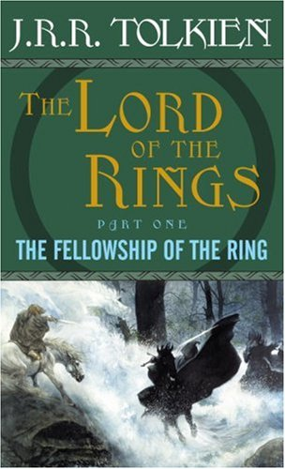
Number THE BOOKS IN THE PICTRES according to the numbers of the BOOK TYPES IN THE LIST :
1.Romance
2.History
3.Autobiography
4.Fantasy
5.Mystery
6.Adventure
7.Sports biography
8.Children’s literature
9.Science fiction
10.Fairytale

Slide 16
Vocabulary worksheet!

Slide 17
Thank you ;-)

