Slide 1
UNIT 5 JUST READ IT!
JUDGING A BOOK BY ITS COVER (pages: 94-96)
LEARN ENGLISH
WITH MAHMOOD!

Slide 2
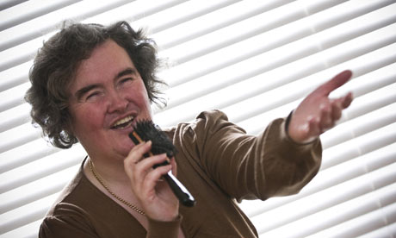
What do you think of me!?

Slide 3
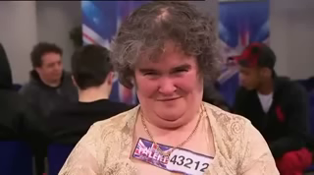
SUSAN BOYLE

Slide 4
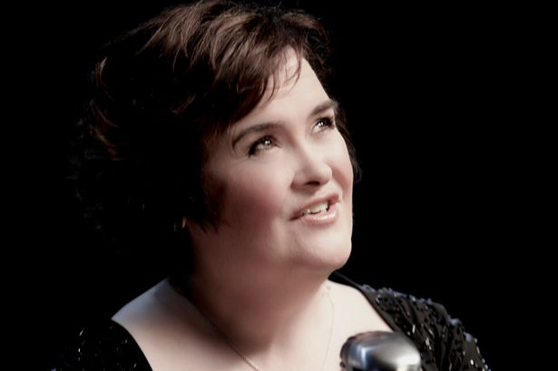
NOW?!

Slide 5
Match the word with its meaning(page: 94)
destroy
difficult
courage
novel
although
pass the time
in order to
half
author
decision
survive
whole
lost
character
بالرغم من
يَقضي الوقت
كل
رواية
ينجو
يدمر
ضائع
قرار
صعب
مؤلف
لكي
شخصية
نصف
شجاعة

Slide 6
Book cover?
Give us information to decide if want to read the book or not.
The title and the illustration are usually the first things we look at when we choose a book, so its important that they attract the reader.

Slide 7
Blurb?
The information on the BACK of the cover is called blurb!
Review: sometimes there are reviews on the book cover. These are short quotes taken from reviews in magazines or newspaper.

Slide 8
Short story elements:

Slide 9
Short story elements:
character: A character is a person, or sometimes even an animal, who takes part in the action of a short story or other literary work.
Setting: The setting of a short story is the time and place in which it happens. Authors often use descriptions of landscape, scene, buildings, seasons or weather to provide a strong sense of setting.

Slide 10
Short story elements:
Plot: A plot is a series of events and character actions that relate to the central conflict.
Conflict: The conflict is a struggle between two people or things in a short story. The main character is usually on one side of the central conflict.
On the other side, the main character may struggle against another important character, against the forces of nature, against society, or even against something inside himself or herself (feelings, emotions, illness).

Slide 11
Short story elements:
Theme: The theme is the central idea or belief in a short story.

Slide 12
Read the blurb again and answer the following three questions: (p. 94-95)
Who is the book about?
What happens in the story?
Where does the story take place?

Slide 13
Thanks for listening!

