Slide 1
It’s show time !
Click

Slide 2
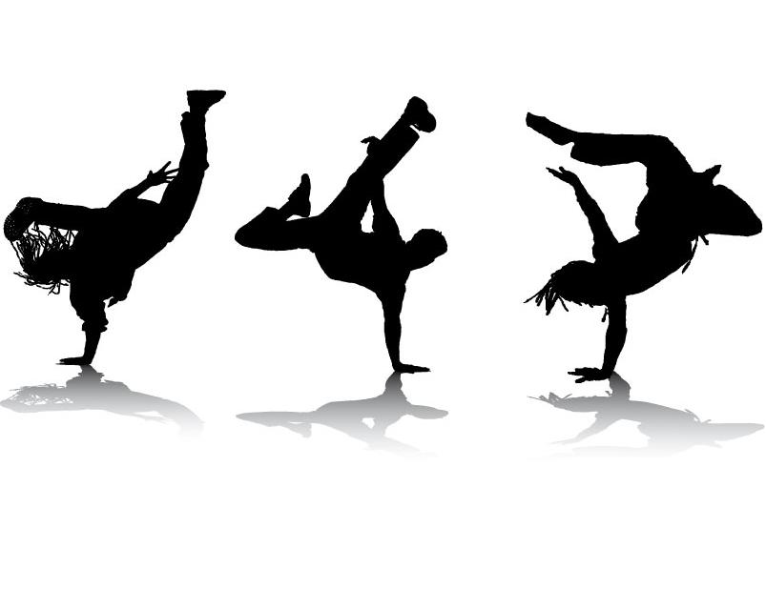
1
2
3
4
5
6
7
8
9
10
11
12

Slide 3
Why did the slaves practice Capoeira ?

Slide 4
In what way Capoeira is different than ballet and breakdancing ?

Slide 5
Why kids started breakdancing ?

Slide 6
How do a ballerina’s graceful movements fool us ?

Slide 7
Why were the firs professional ballet dancers men ?

Slide 8
What is berimbau ?

Slide 9
What a breakdancer boy or girl is called ?

Slide 10
Why do ballet dancers wear special shoes ?

Slide 11
Why should breakdancers dress comfortably ?

Slide 12
How is ballet different now from the past ?

Slide 13
The singer and the dancers both …….

Slide 14
What does Capoeira teach people ?

