Slide 1
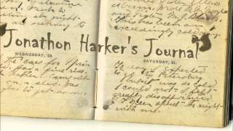
Jonathan Harker’s diary

Slide 2
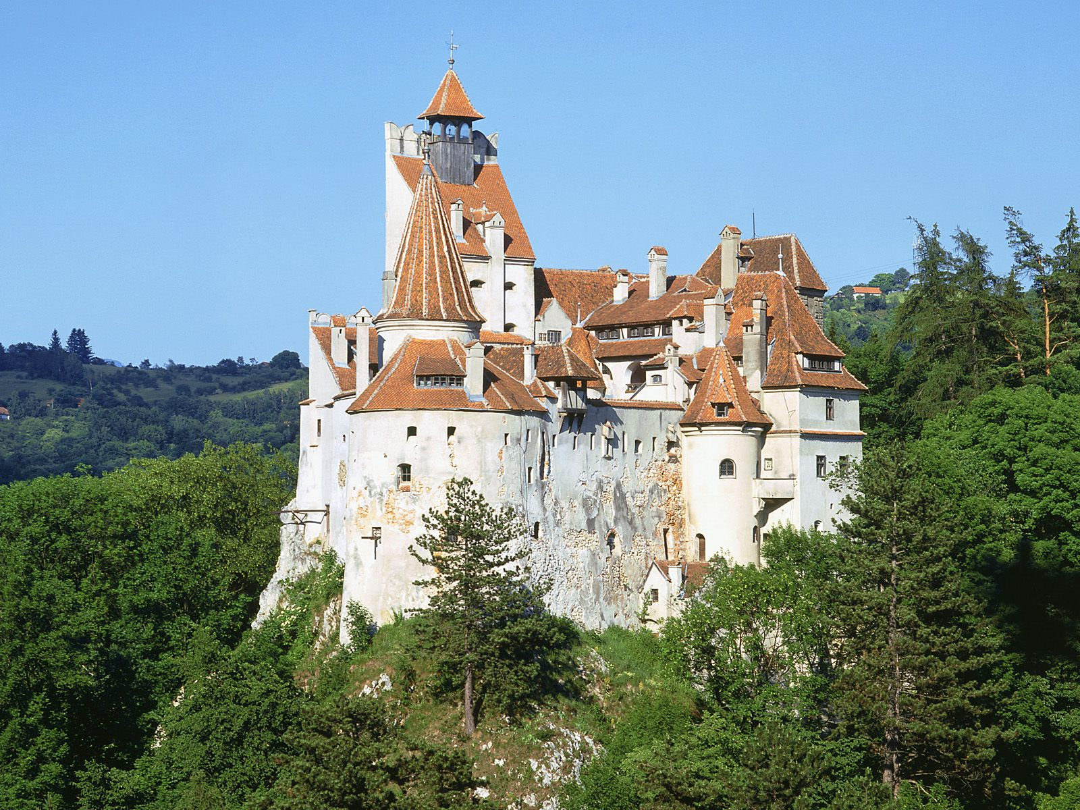
1
2
6
3
5
4

Slide 3
2
6
3
5
4

Slide 4
6
3
5
4

Slide 5
6
5
4

Slide 6
6
5

Slide 7
6

Slide 9
Why did Jonathan want to escape from the castle?
Jonathan wanted to escape from the castle because he had been attacked or in some way threatened.

Slide 10
What is the way to get into the Count’s room?
Jonathan got to the Count’s room by CRAWLING through his window on the castle wall.

Slide 11
Jonathan found the Count in his room. YES/NO
NO.

Slide 12
What is the antonym of: bottom, dark.
Bottom; up / top
Dark; light

Slide 13
What signs of life did the Count have?
The signs of life were his open eyes and color in his face. He also had red lips.

Slide 14
Why did Jonathan run away from the room?
Jonathan ran away from the room because he was frightened by the Count’s look of hate.

Slide 16
1. Why did Jonathan want to escape from the castle?
Jonathan wanted to escape from the castle because he had been attacked or in some way threatened.

Slide 17
2. How did Jonathan get into the Count’s room? Why did he choose this way?
Jonathan got to the Count’s room by crawling through his window on the castle wall. Jonathan did this because the door of the count’s room was always locked and he had seen the Count get in this way.

Slide 18
3. What did Jonathan discover?
Jonathan discovered the Count, lying in a wooden box.

Slide 19
4. a. Jonathan was sure that the Count was dead. True or False? b. which words in the text helped you answer?
False.
“he was either dead or asleep. I could not say which.”

Slide 20
5. a. What signs of life did the Count have?
a. The signs of life were his open eyes and color in his face. He also had red lips.

Slide 21
b. What signs of death did the Count have?
b. The signs of death were his stony eyes. There was no sign of movement, no pulse, no breath and no beating of the heart.

Slide 22
6. Why did Jonathan run away from the room?
Jonathan ran away from the room because he was frightened by the Count’s look of hate.

Slide 23
7. Did Jonathan find the key? How do you know?
Jonathan didn’t find the key because he didn’t find them on the Count. He didn’t look any more because he was afraid.

