Slide 1
1. على كُلِ عُضوٍ في المجموعةِ الجلوس بهُدوٍء. 2. الضغطِ على الصورةِ المرفقةِ للتمكن من الدخولِ إلى لعبةِ البازل. 3. تَركيب قطع البازل حتى نصل إلى الصورةِ التي تم الضغطُ عليها في البندِ الثاني. 4.كتابة عَشرةِ أَسطر عن الصورةِ المركبةِ.

Slide 2
1
الفرقة رقم 1.

Slide 3
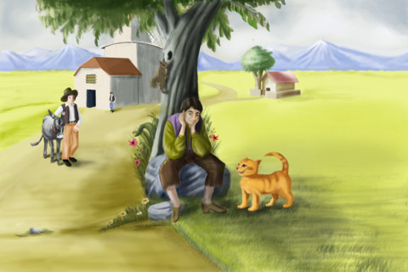
___________________________________
___________________________________
___________________________________
___________________________________
___________________________________
___________________________________
___________________________________
___________________________________
___________________________________
___________________________________
___________________________________

Slide 4
الفرقة رقم 2.

Slide 5
___________________________________
___________________________________
___________________________________
___________________________________
___________________________________
___________________________________
___________________________________
___________________________________
___________________________________
___________________________________
___________________________________

Slide 6
الفرقة رقم 3.

Slide 7
___________________________________
___________________________________
___________________________________
___________________________________
___________________________________
___________________________________
___________________________________
___________________________________
___________________________________
___________________________________
___________________________________

Slide 8
الفرقة رقم 4.

Slide 9
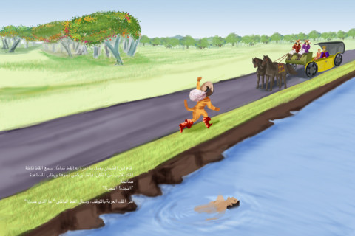
___________________________________
___________________________________
___________________________________
___________________________________
___________________________________
___________________________________
___________________________________
___________________________________
___________________________________
___________________________________
___________________________________

Slide 10
الفرقة رقم 5.

Slide 11
___________________________________
___________________________________
___________________________________
___________________________________
___________________________________
___________________________________
___________________________________
___________________________________
___________________________________
___________________________________
___________________________________

Slide 12
الفرقة رقم 6.

Slide 13
___________________________________
___________________________________
___________________________________
___________________________________
___________________________________
___________________________________
___________________________________
___________________________________
___________________________________
___________________________________
___________________________________

